Slide 1
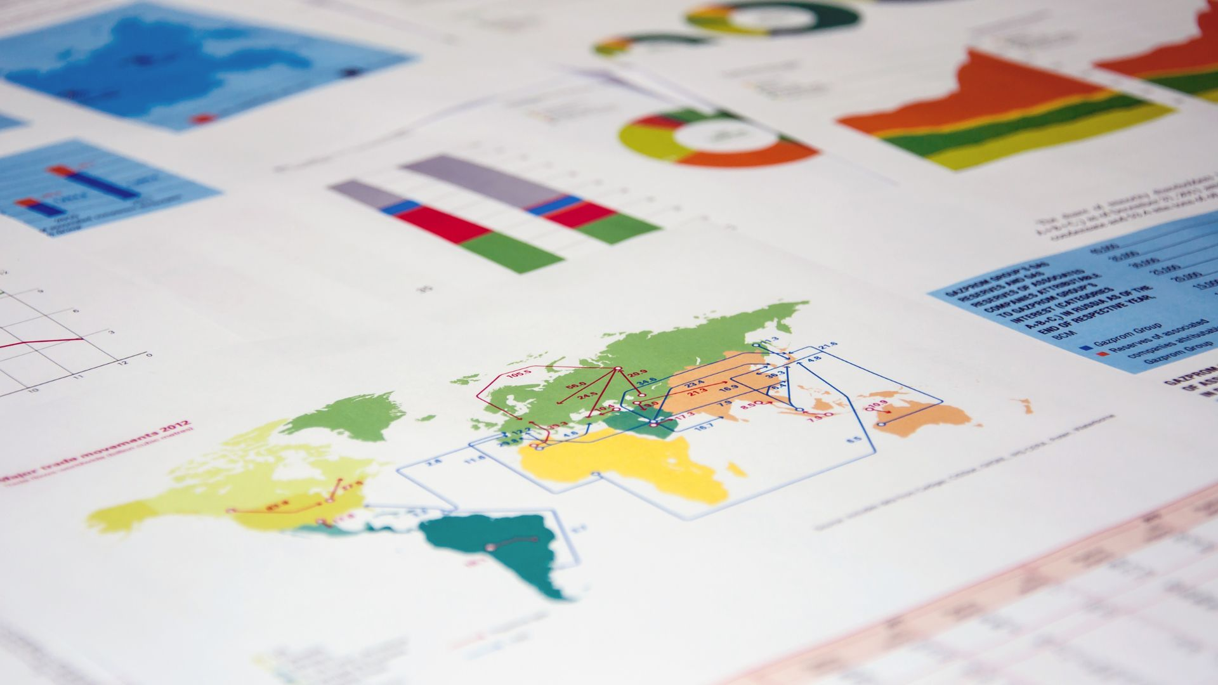
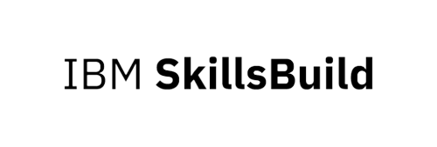
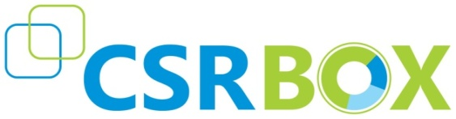
Rossmann Store Sales Prediction
Team :- Data Freaks
Notes:
https://medium.com/analytics-vidhya/rossmann-store-sales-prediction-998161027abf
https://www.scribd.com/document/549591875/Rossmann-Sales-Prediction-Presentation#

Slide 2

TEAM MEMBERS
1.Pallavi
2.Mohd Asim
3.Farheen Jahan

Slide 3

Workload Division
Contribution of each team member in project
Pallavi – Project Design, Planning and Code Development. Identification of Industry and associated use case.
Farheen Jahan – Project Design, Planning, Code Development and Documentation. Identification of Industry and associated use case.
Mohd Asim – Identification of Industry and associated use case. Data gathering.

Slide 4
INTRODUCTION
Rossmann operates over 3,000 drug stores in 7 European countries. Currently, Rossmann store managers are tasked with predicting their daily sales for up to six weeks in advance. Store sales are influenced by many factors, including promotions, competition, school and state holidays, seasonality, and locality. With thousands of individual managers predicting sales based on their unique circumstances, the accuracy of results can be quite varied.
Dirk Rossmann GmbH, commonly referred to as Rossmann, is one of the largest drug store chains in Europe with around 56,200 employees and more than 4000** stores. In 2019 Rossmann had more than €10 billion turnover in Germany, Poland, Hungary, the Czech Republic, Turkey, Albania, Kosovo and Spain. The company was founded in **1972 by Dirk Rossmann with its headquarters in Burgwedel near Hanover in Germany. The Rossmann family owns 60% of the company. The Hong Kong-based
A.S. Watson Group owns 40%, which was taken over from the Dutch Kruidvat in 2004.
The product range includes up to 21,700 items and can vary depending on the size of the shop and the location. In addition to drugstore goods with a focus on skin, hair, body, baby and health, Rossmann also offers promotional items ("World of Ideas"), pet food, a photo service and a wide range of natural foods and wines. There is also a perfume range with around 200 commercial brands. Rossmann has 29 private brands with 4600 products (as of 2019). In 1997, the first own brands Babydream, Facelle, Sunozon and Winston were introduced. The best-known Rossmann brands are Isana (skin, hair and body care), Alterra (natural cosmetics), domol (cleaning and laundry detergents) alouette (paper tissues etc).

Slide 5

Problem Statement
Rossmann is a European drug distributor which operates over 3,000 drug stores across seven European countries.
Currently, Rossmann store managers are tasked with predicting their daily sales for up to 6 weeks in advance. Store sales are influenced by many factors , including promotions , competition ,school and state holidays , saeasonality , and locality .
With thousands of individual managers predicting sales based on their unique circumstances , the accuracy of result can be quite varied.
The main objective is to understand existing data and after identifying the key factors that will predict future sales, a predictive model will be built for making forecasts about future sales.

Slide 6

Objective
Predict sales for 6 weeks in advance given the data.
Minimize the given metric as much as possible.

Slide 7

Technology Stack & Requirements
Software Requirments
Hardware Requirments
Platform : Google Colab, GitHub
Operating System : Win 7 or higher version
Processor : Core i3
RAM : 4 GB
Hard Disc : 50 GB

Slide 8
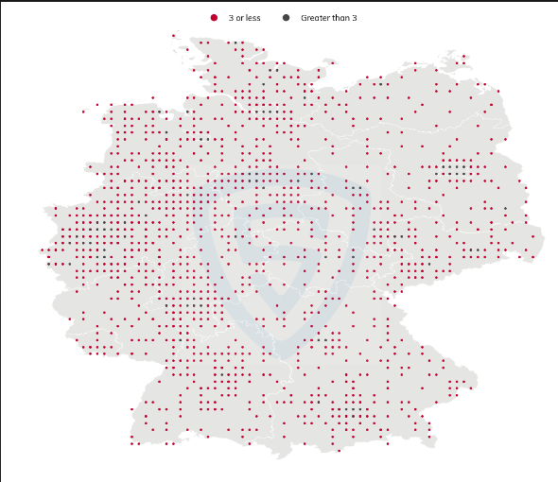
Rossmann stores location in Germany

Slide 9
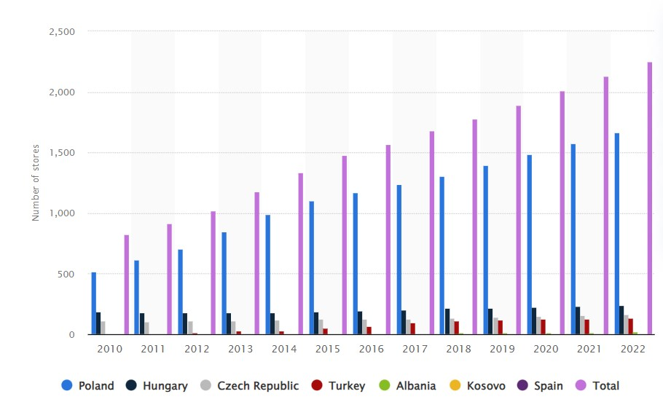
Number of Rossmann stores outside Germany from 2010 to 2022

Slide 10
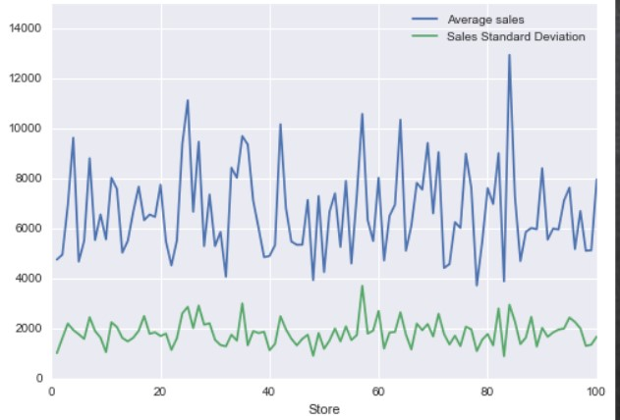
Average sales and standard deviation of sales
This graph shows the average sales and standard deviation of sales

Slide 11
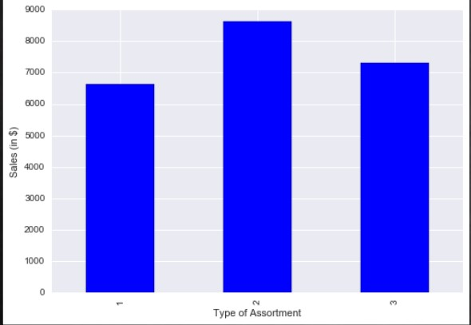
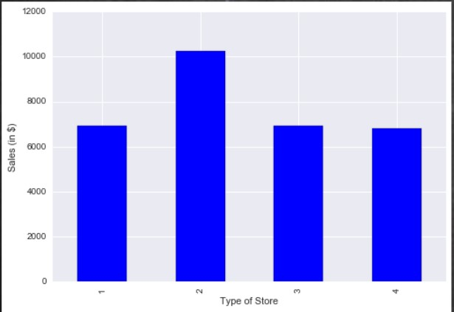
This graph show the correlation between sales and assortment
This graph shows the correlation between sales and store type

Slide 12
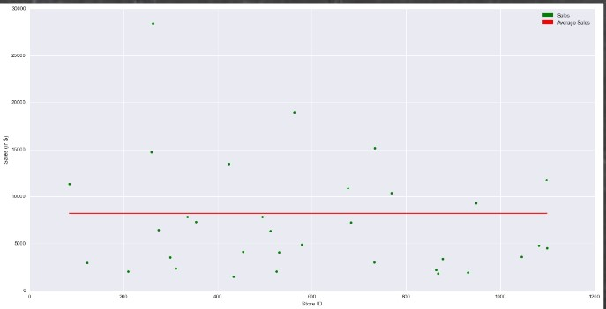
Actual sales vs average sales per store on Sundays

Slide 13
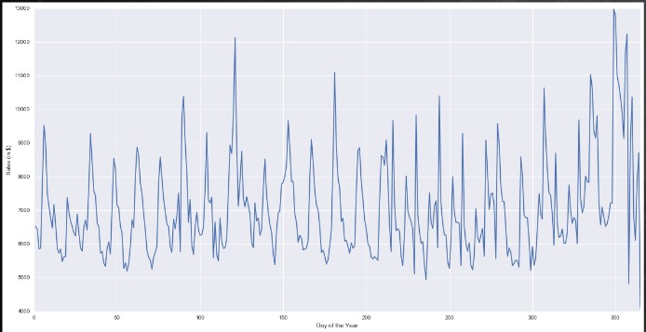
Average sales for day of the year

Slide 14
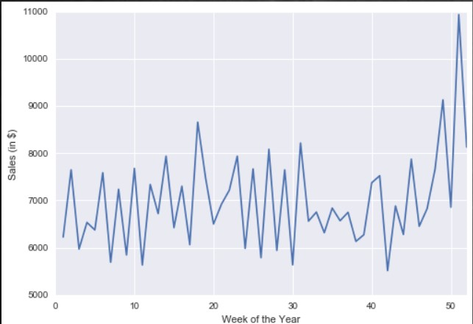
Average sales for week of the year

Slide 15
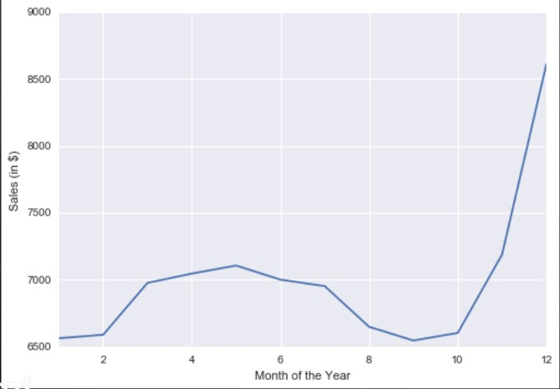
Average sales for month of the year

Slide 16

Outcomes/ Results
DayOfWeek was found to be the most important feature(using xgboost regressor), which is contributing the highest in
predicting the target variable.
We found 89% accuracy through linear regression.
The Regularization techniques of linear regression(Lasso, and Ridge) did not help in improving the accuracy much.
In decision tree regression, we found 97% accuracy.
The ensembles of decision tree i.e. Random forest gave us the highest accuracy i.e. 98% in predicting the target variable.
However through Xgboost Regressor, we got 93% accuracy.
So we found Random forest to be the best performing algorithm.
This Photo by Unknown Author is licensed under CC BY

Slide 17
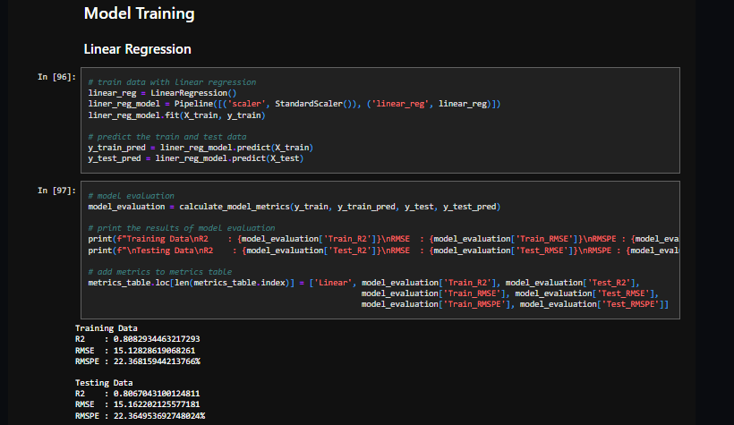
Outcome snapshot
This Photo by Unknown Author is licensed under CC BY

Slide 18

Conclusion/ Future scope
Promotions are playing a vital role in sales.
Variation in sales for stores open on Sundays.
Usage of time series might help in the reduction of error rate.
Maintain inventory levels on the basis of product types.
Can be used by stores managers effectively for sales forecasting.

Slide 19



